Slide 1

PUBLIC SERVICES STATISFACTION SURVEY
MSPM’S
Deogiri Institute of Engineering and Management Studies, Aurangabad
Department of Computer Science and Engineering
A Presentation of Seminar II
Team Members :
ROLL NO.27041 POOJA BANSWAL CSE(AIML)
ROLL NO.27042 POOJA BHARAD CSE(AIML)
ROLL NO.27045 PRAPTI BANKAR CSE(AIML)
Under the Guidance of
MS. Sugandha Nandedkar

Slide 2

CONTENT
Goals and Subgoals of the Survey
Target Population
Questionnaire Design
Data Collection Form (working link and response)
Python Code along with the output screenshot for the Data Pre-processing and Data Visualization of your collected data
Conclusion and Personal Analysis

Slide 3

GOALS AND SUBGOALS
Goals:
Identify the public need and their problem
Subgoal:
Services most preferable
Which area is facing problem
If the facilities are provided properly
Opinion about the services

Slide 4

TARGET POPULATION
We have restricted are survey to a specific group of age that is above 18 years
We got different responses from different age groups. We have planned questions that could be answered by all people above age 18.

Slide 5
QUESTIONNAIRE DESIGN
According to our topic we designed the question to analyse the issues of people related to public services in all over the Aurangabad.
more number of responses will have to analyse the survey and conclusion which makes easy to us.

Slide 6

DATA COLLECTON
For the Data collection we were used the google form to collect the data. Nowadays everyone is using the google mail so with the help of this digital form we collected the data from the target population.
https://docs.google.com/forms/d/1ua-bh2vfJ1ld11gHNwga5mr-HyIAQlCdfBeGgqCd85I/edit#responses

Slide 7
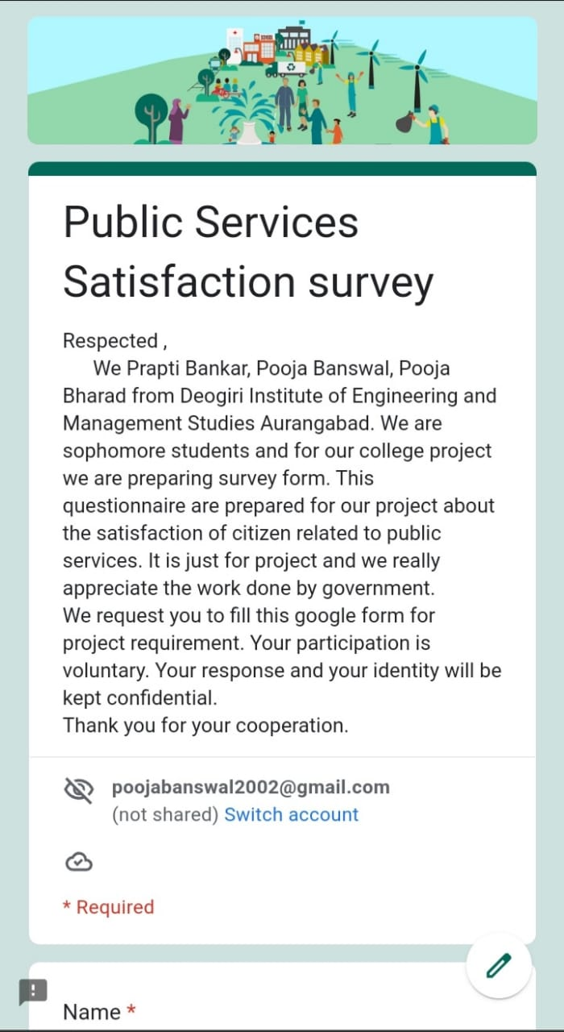
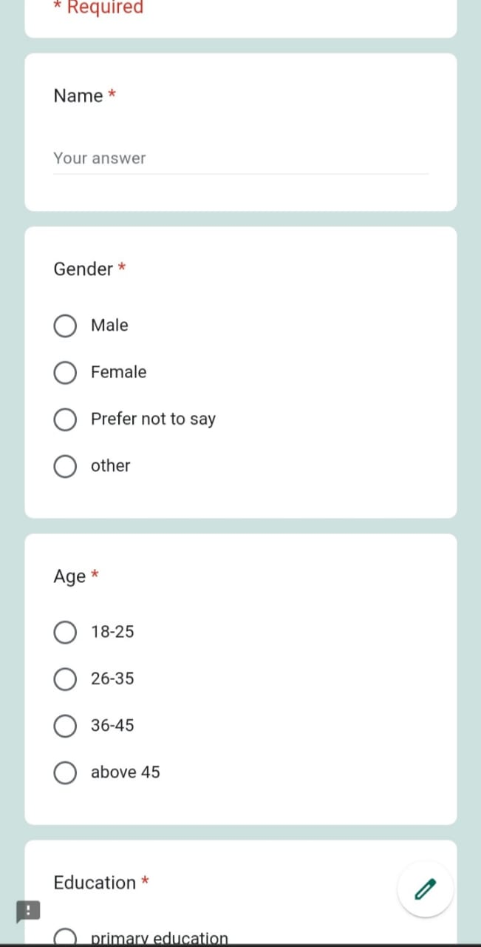
Screenshots of Questions

Slide 8
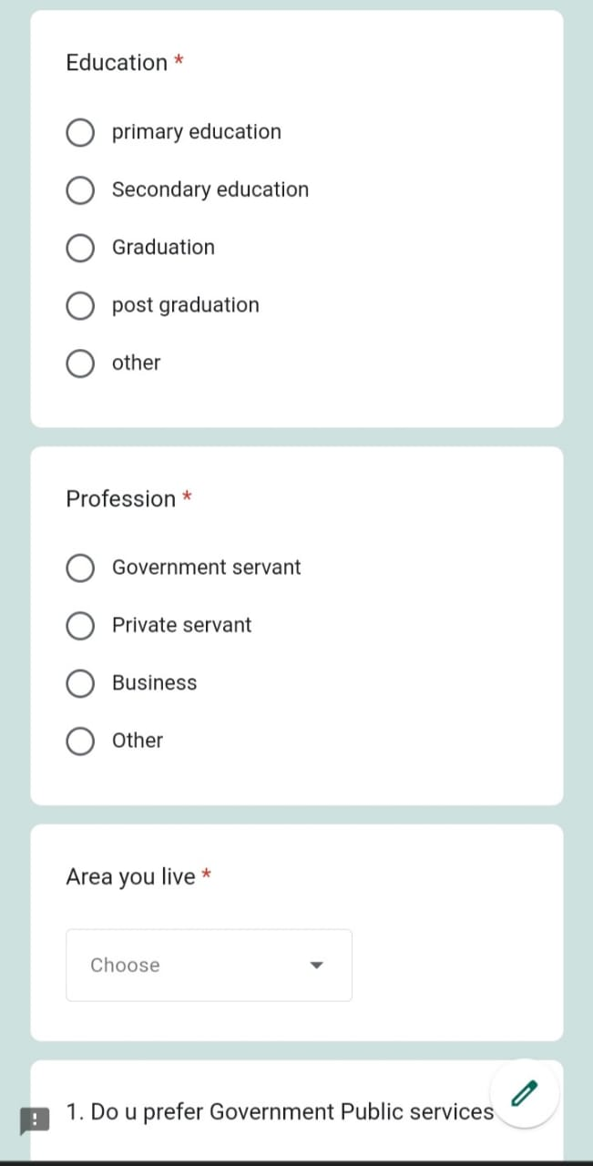
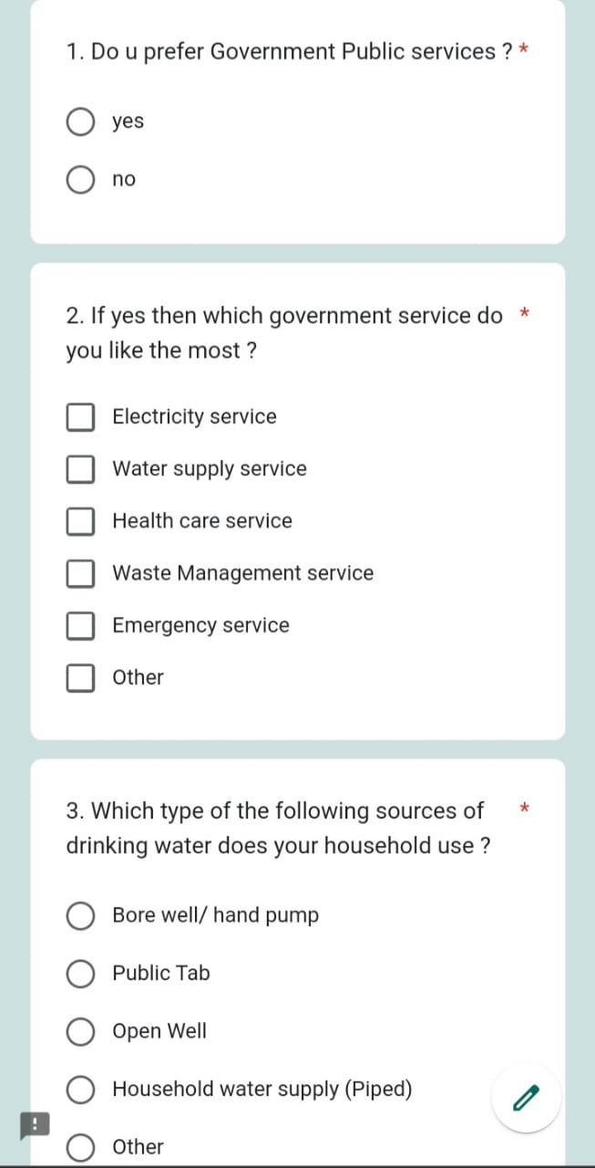
Screenshots of Questions

Slide 9
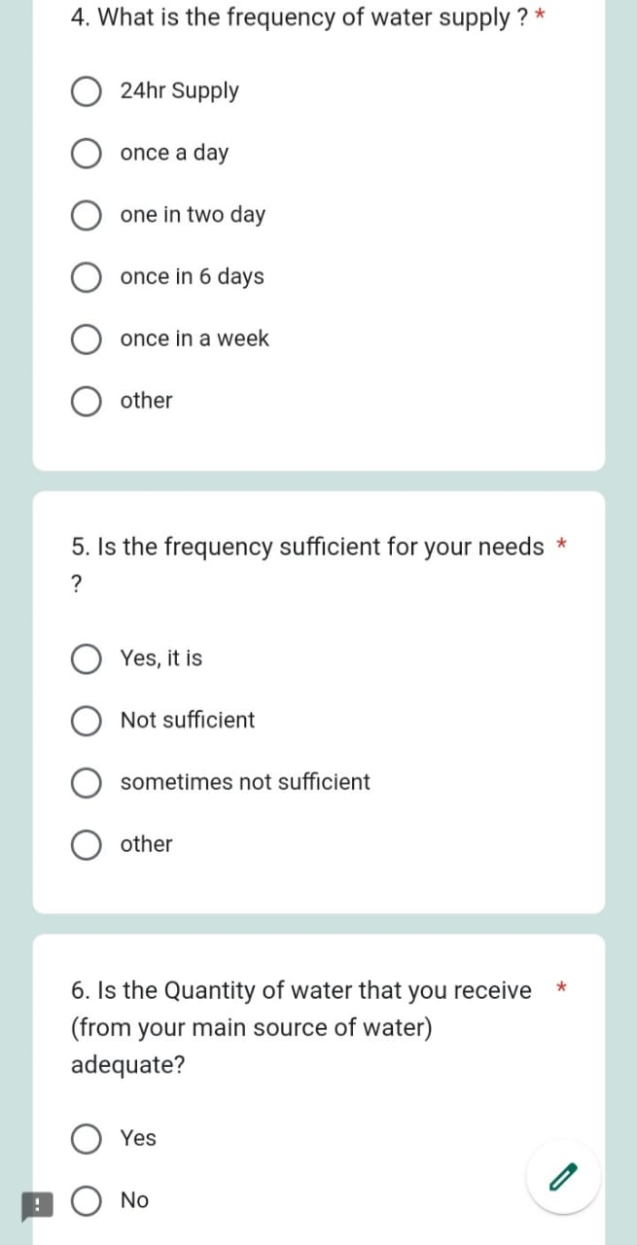
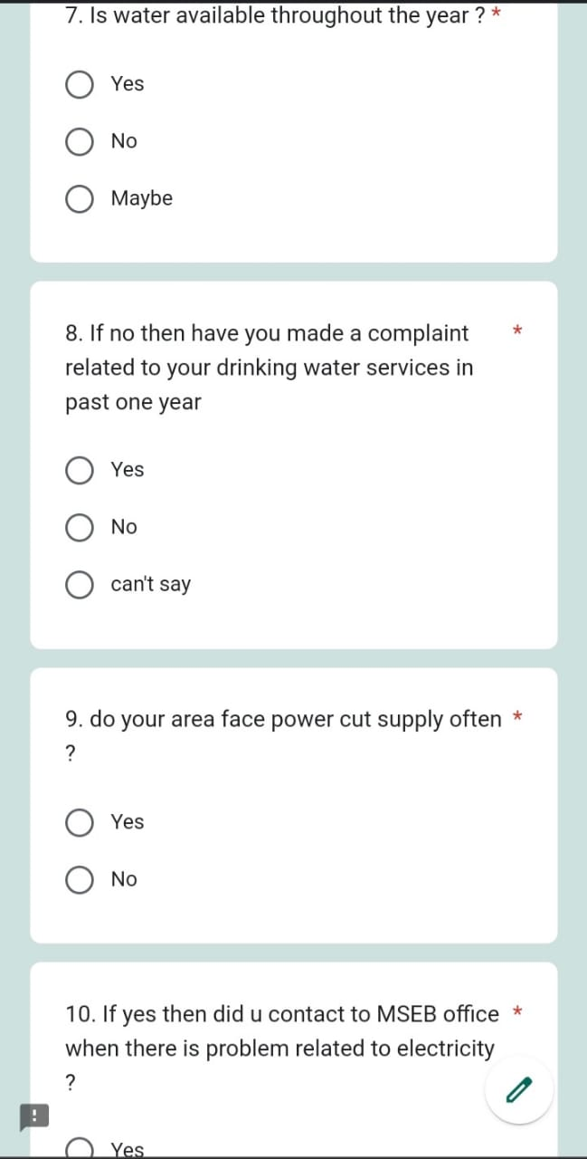
Screenshots of Questions

Slide 10
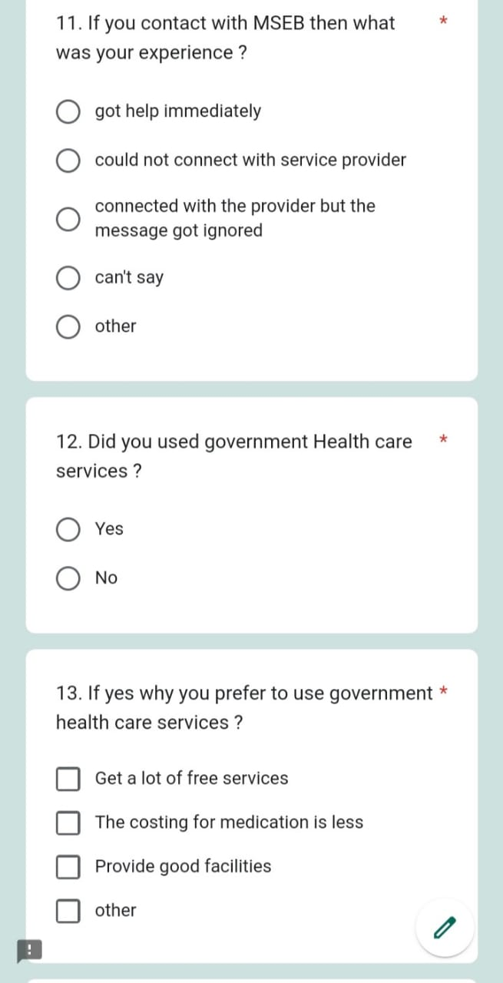
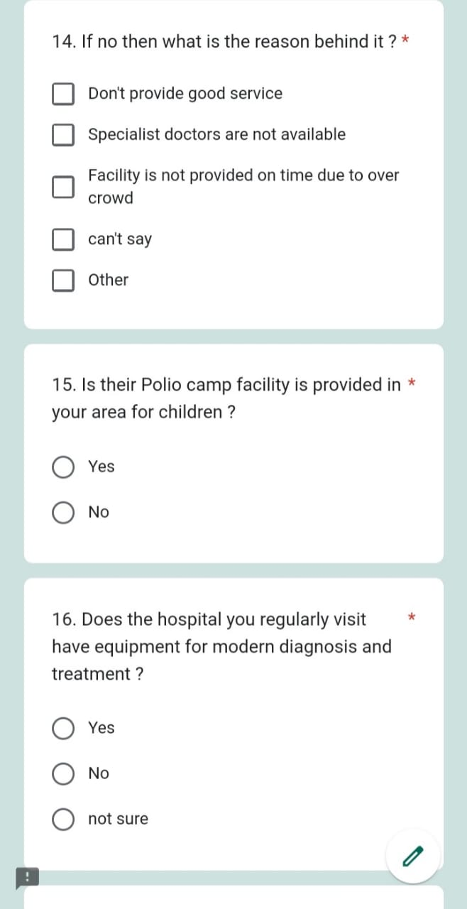
Screenshots of Questions

Slide 11
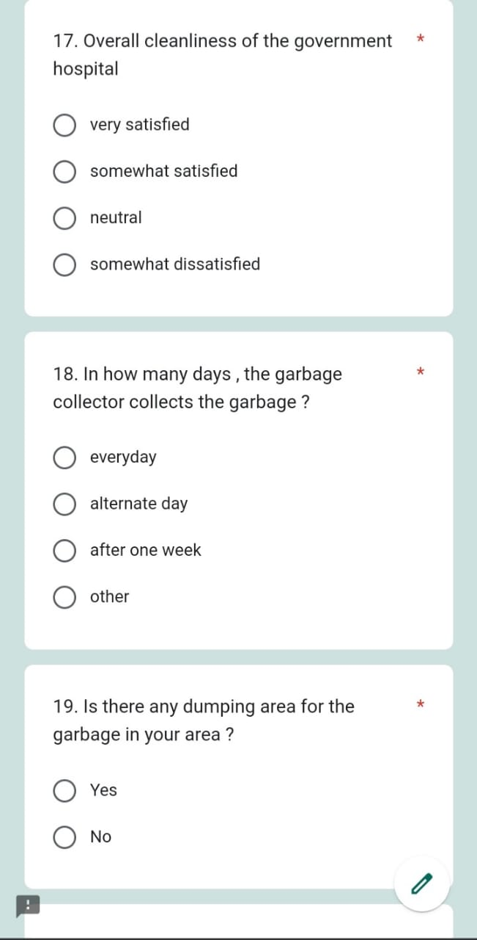
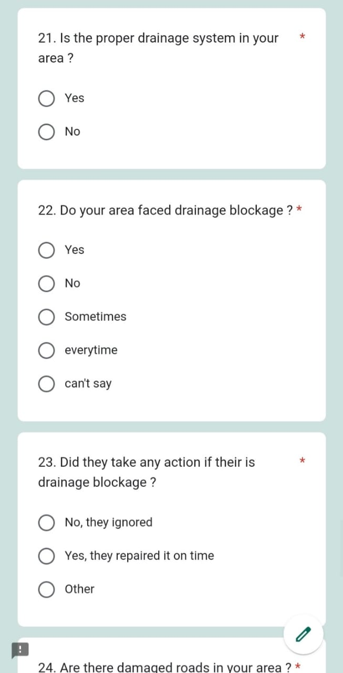
Screenshots of Questions

Slide 12
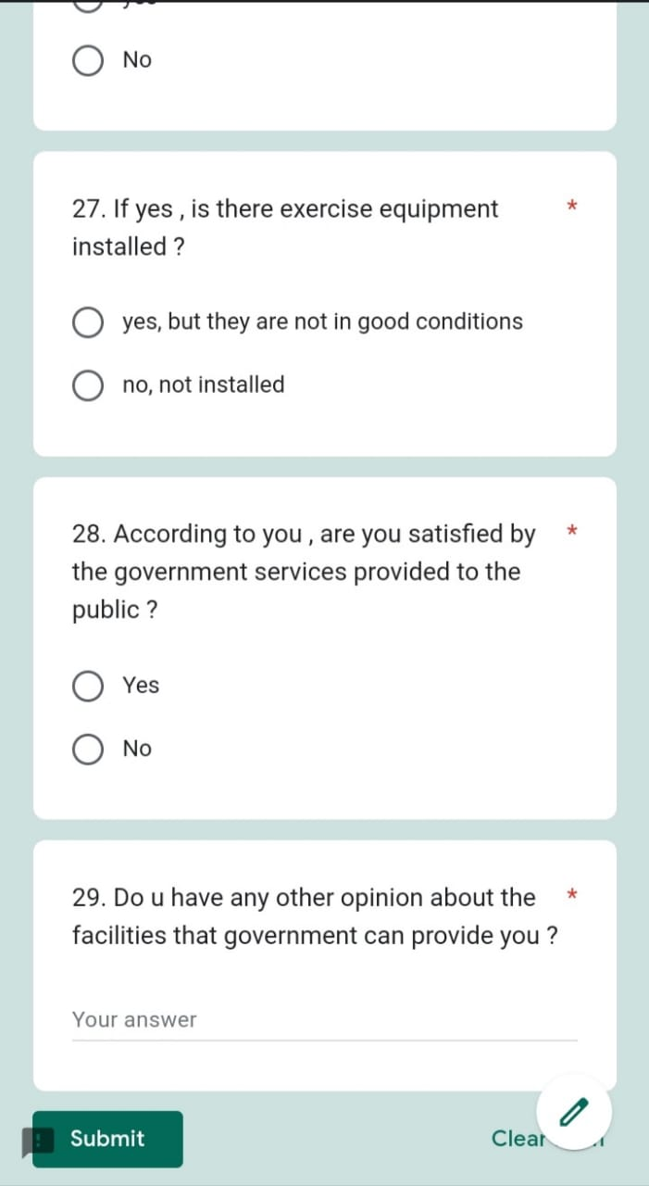
Screenshots of Questions

Slide 13
DATA PRE-PROCESSING USING EDA METHOD
We have used EDA [Exploratory Data Analysis] method for data pre-processing
EDA techniques allow for effective manipulation of data sources, enabling data scientists to find the answers they need by discovering data patterns, spotting anomalies, checking assumptions, or testing a hypothesis.
Exploratory data analysis can help detect obvious errors, identify outliers in datasets, understand relationships, unearth important factors, find patterns within data, and provide new insights.

Slide 14
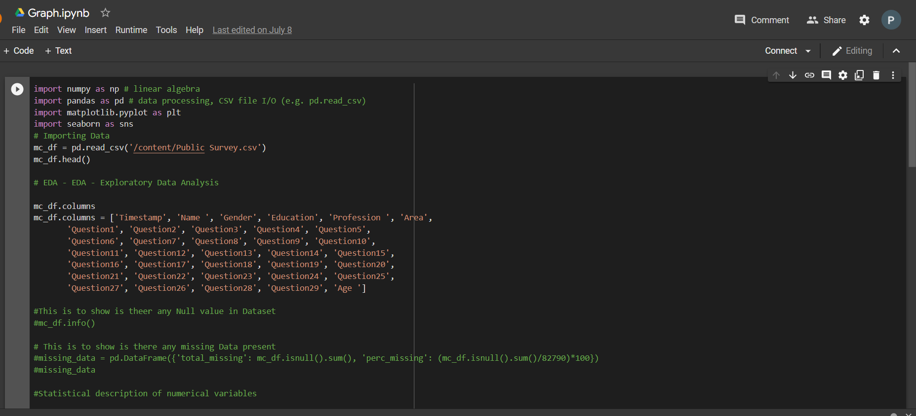
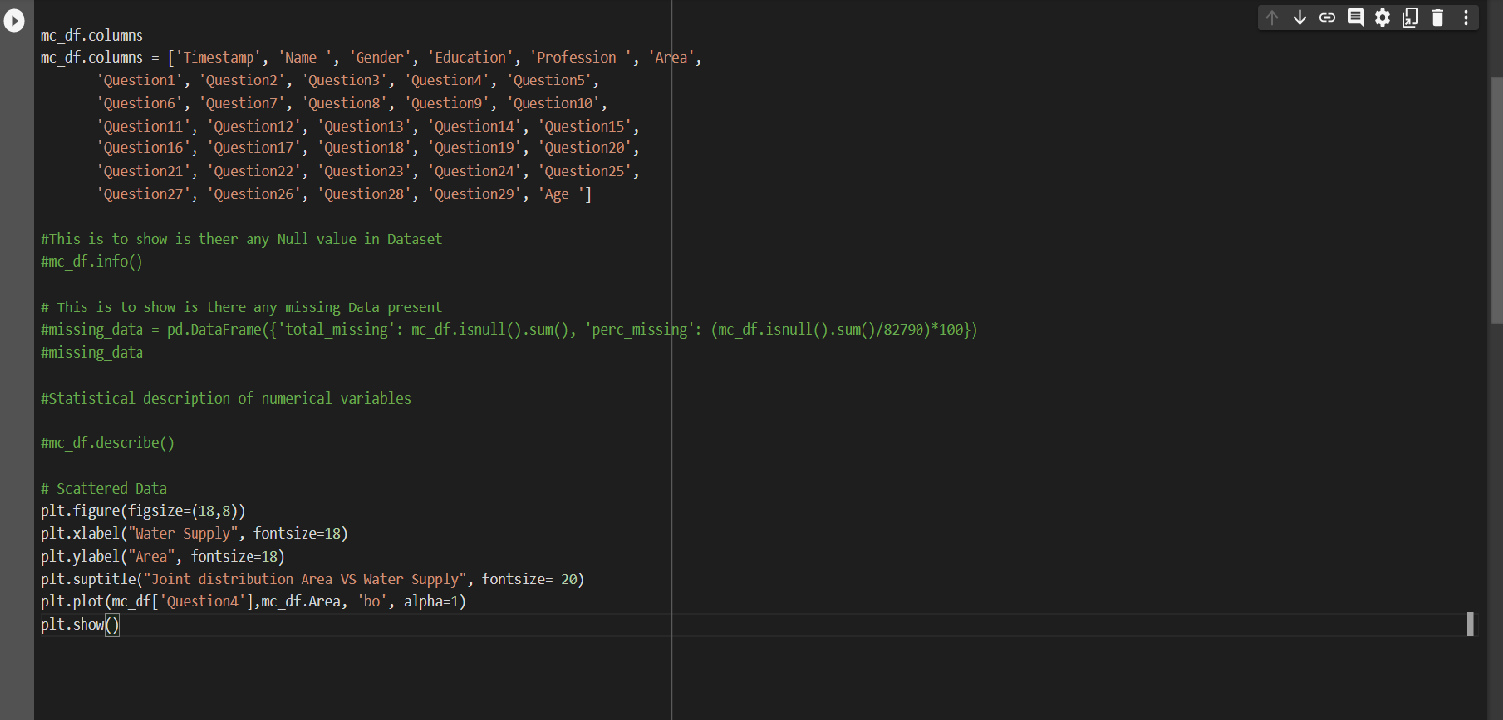
CODE FOR GRAPH 1:

Slide 15
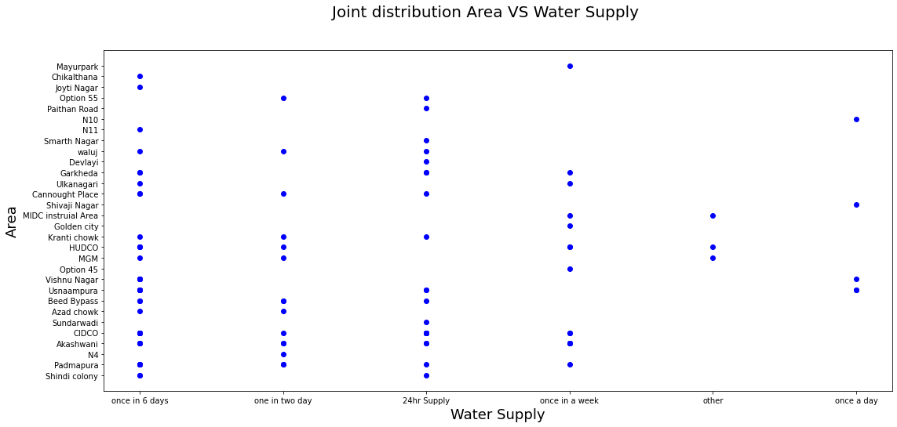
SCATTER PLOT GRAPH FOR WATER SUPPLY V/S AREA

Slide 16
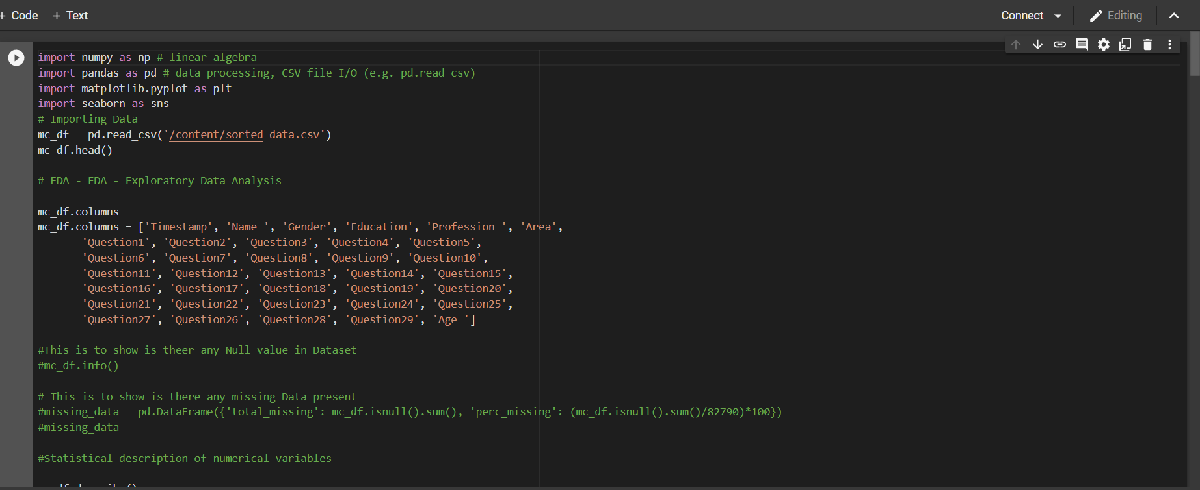
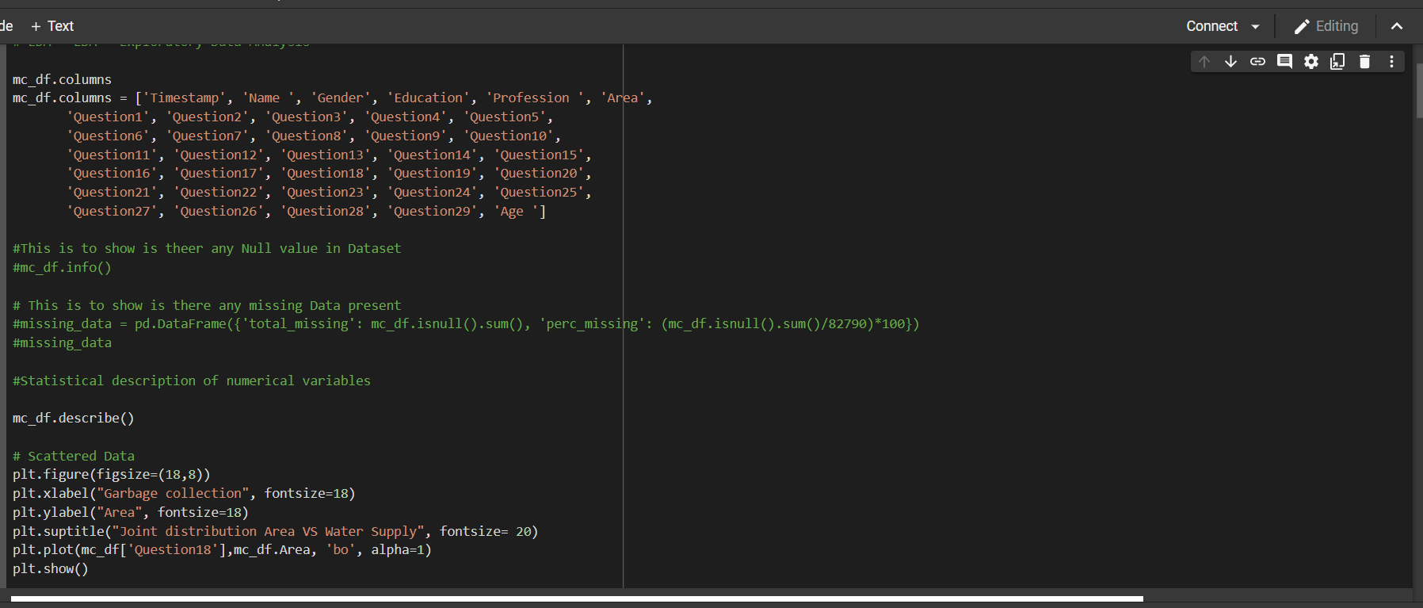
CODE FOR GRAPH 2:

Slide 17
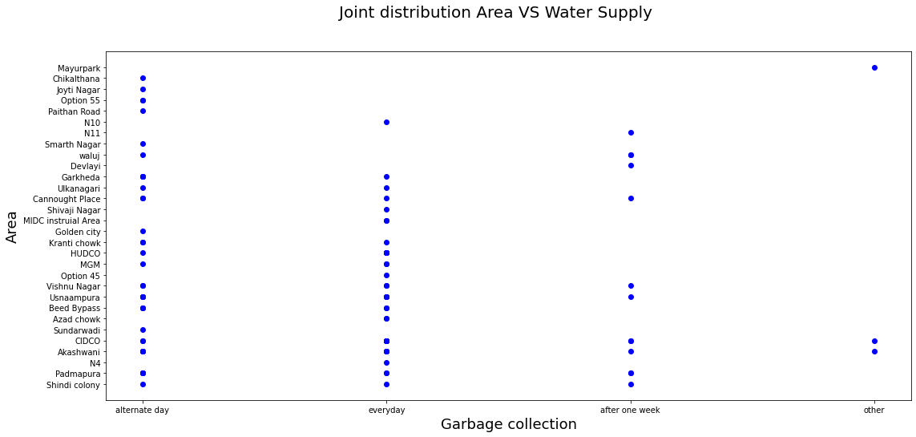
SCATTER PLOT GRAPH FOR GRABAGE COLLECTION V/S AREA

Slide 18
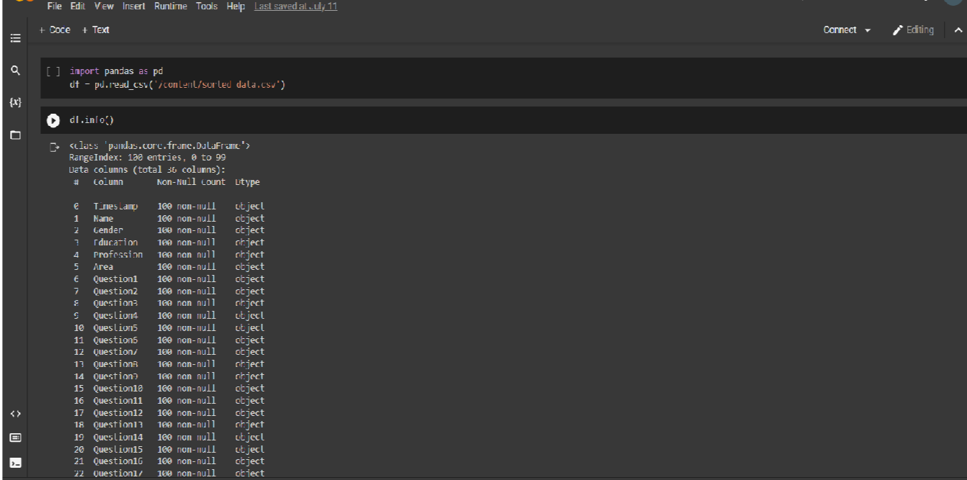
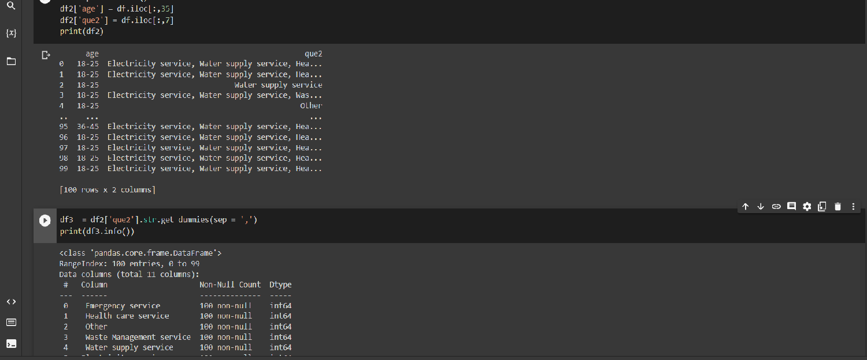
CODE FOR GRAPH 3:

Slide 19
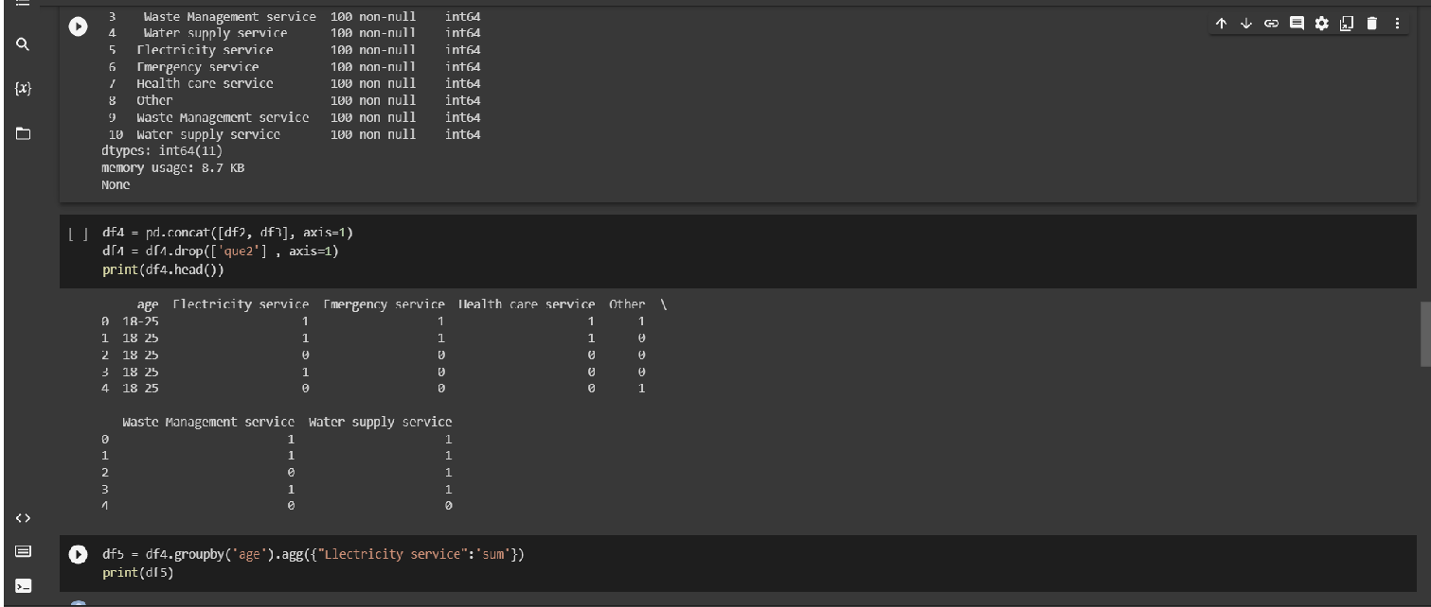
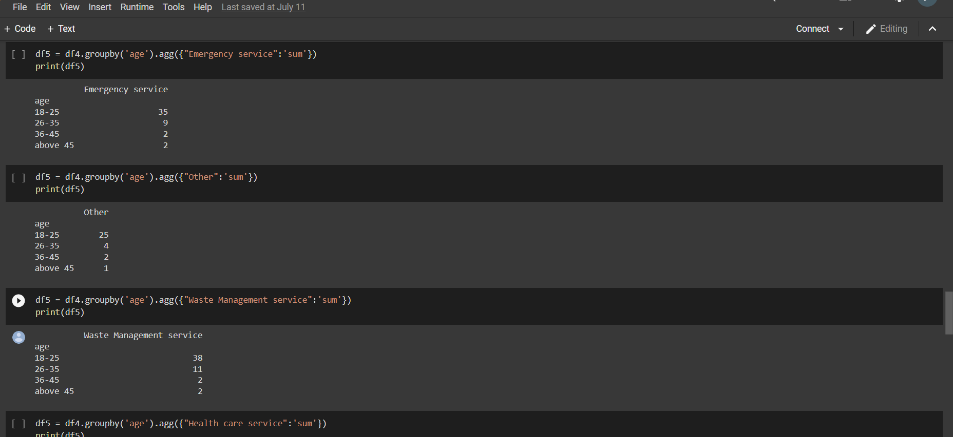
CODE FOR GRAPH 3:

Slide 20
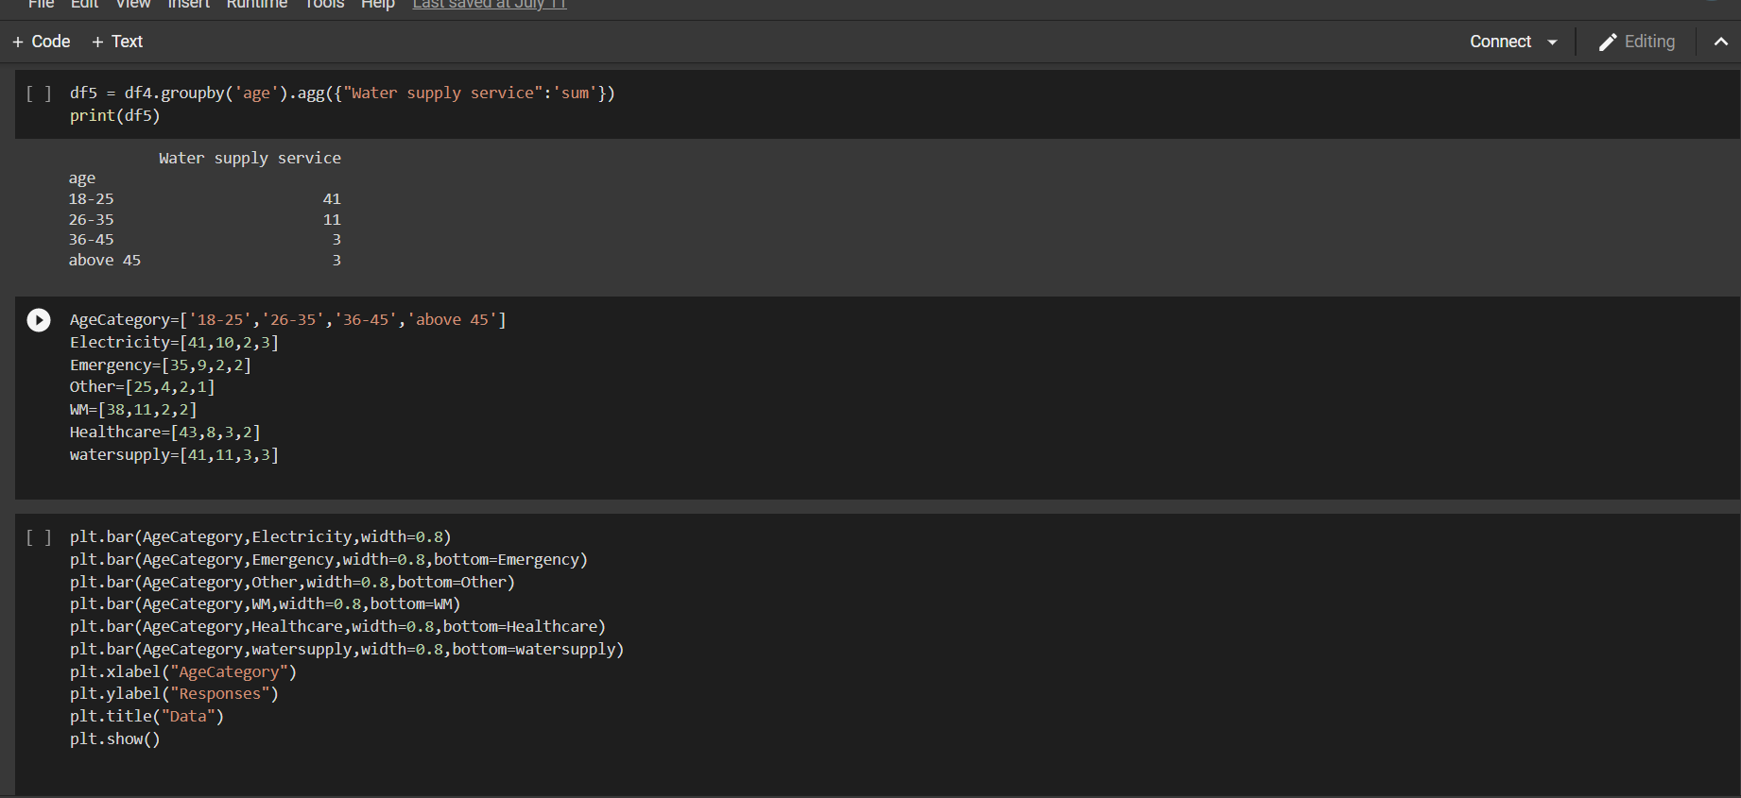
CODE FOR GRAPH 3:

Slide 21
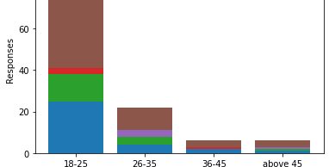
STACKED BAR GRAPH FOR AGE CATEGORY V/S PUBLIC SERVICES

Slide 22
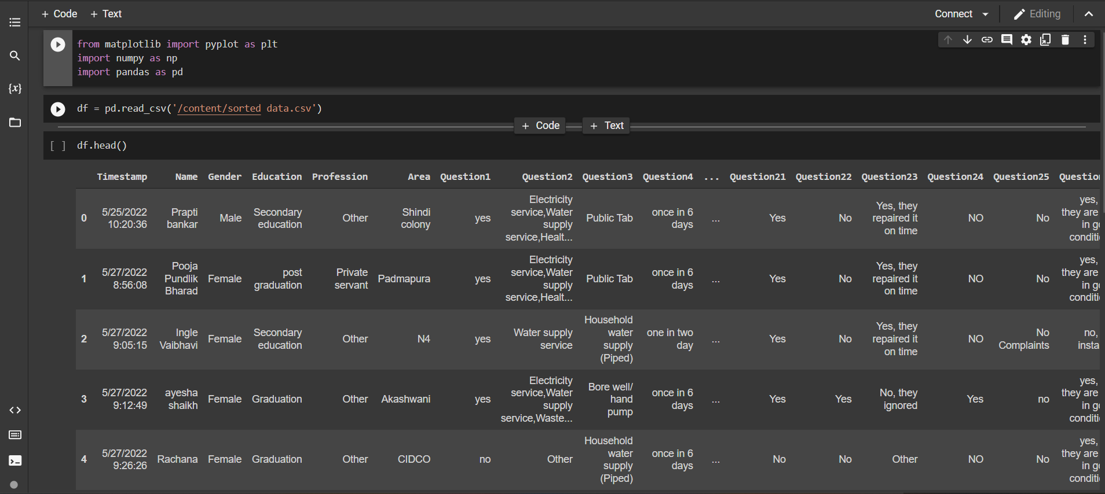
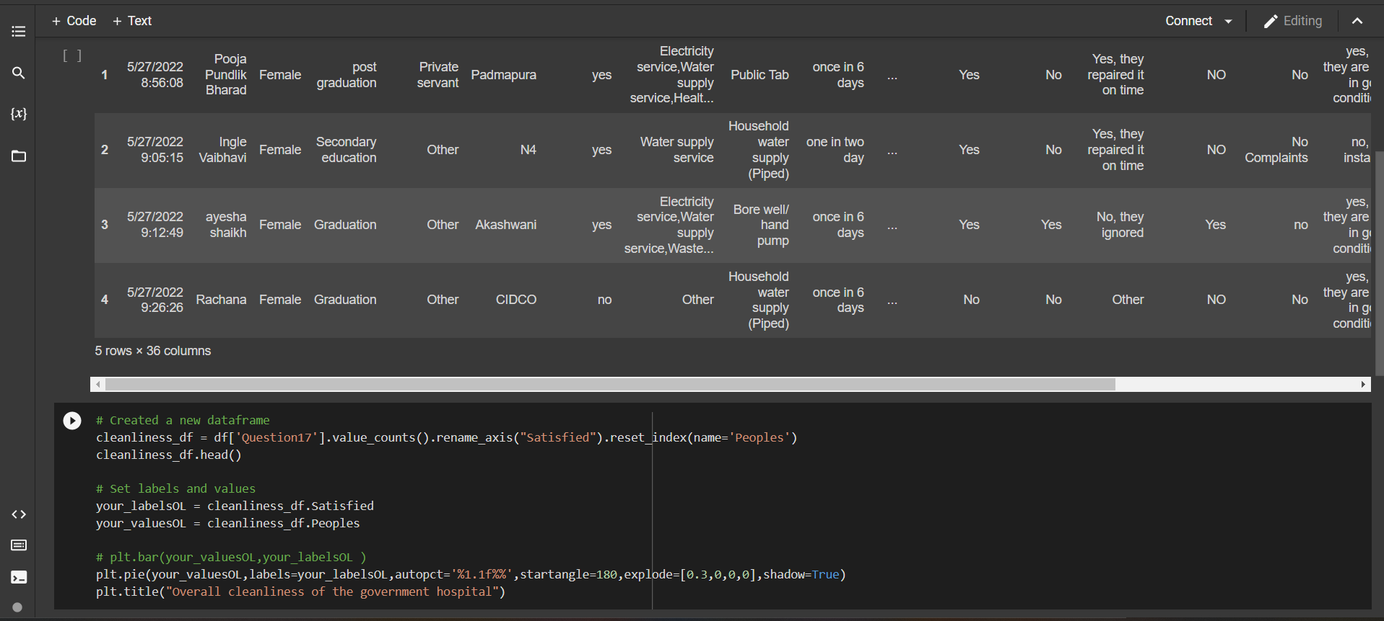
CODE FOR GRAPH 4:

Slide 23
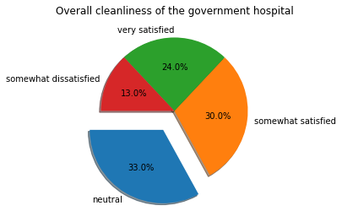
PIE CHART FOR OVERALL CLEANINESS OF THE GOVERNMENT HOSPITALS

Slide 24
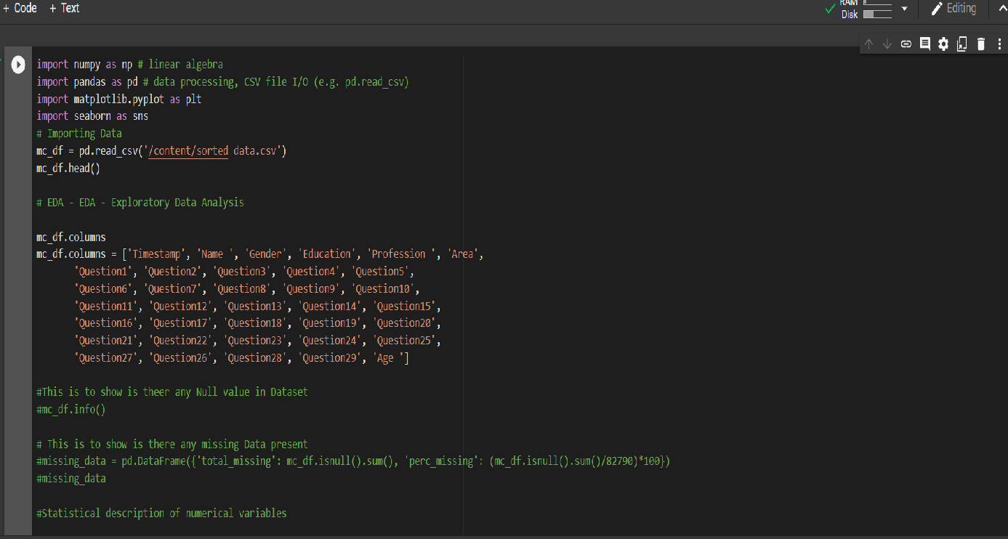
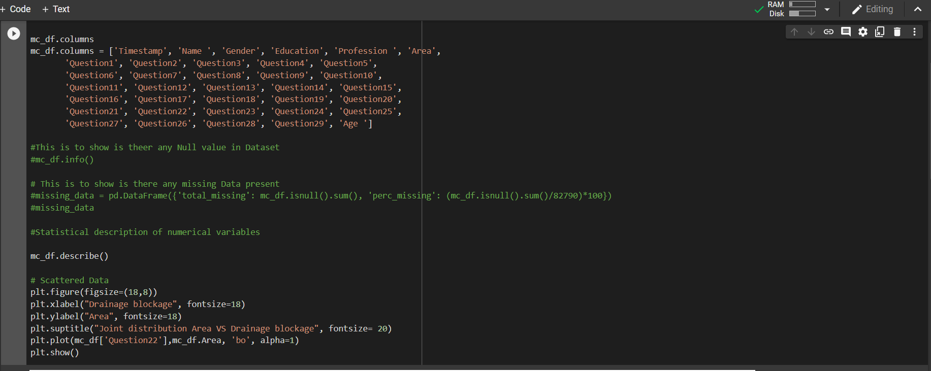
CODE FOR GRAPH 5:

Slide 25
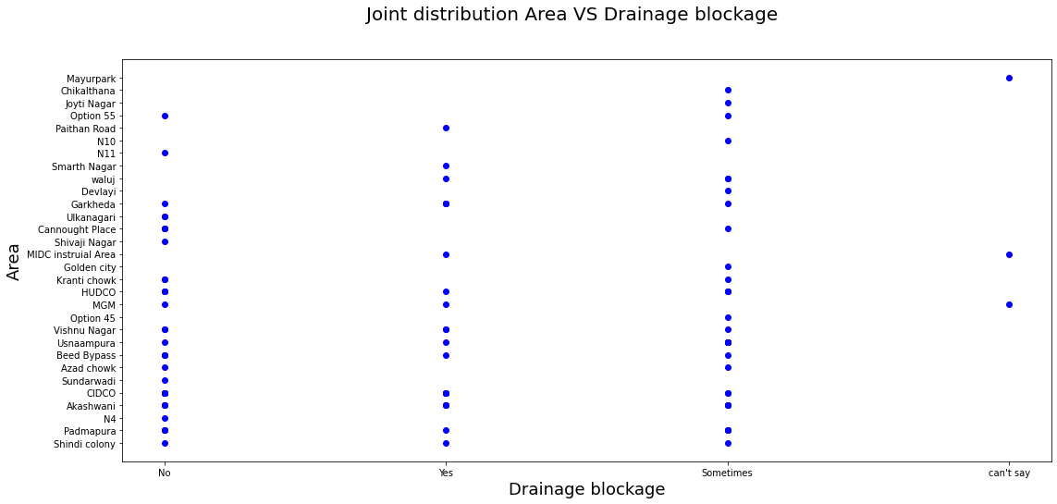
SCATTER PLOT FOR DRAINGE BLOCKAGE V/S AREA

Slide 26
CONCLUSION
In this survey, we focus on the facilities provided to local people by government such as water services, electricity services, healthcare services, etc. We have plotted the graphs focusing on the goals of the survey and identify the problems faced by the people in respective areas. ­­­­­­We successfully got the responses from the people and identified the problems and we hope the output we got from the survey would be beneficial to solve the problems.

Slide 27
THANKYOU

